Slide 1
A PROPOSAL TO INVESTIGATE THE INEFFICIENT AND UNSAFE CHECK-IN/BOARDING PROCESS AT ANKARA YHT TRAIN STATION
Muhammad Arham Khan
21701848
ENG 401 - 18

Slide 2
INTRODUCTION
More than 4.3 million passengers commute using trains per day in Turkey
Most used mode of transport
Usually the ticket purchasing process is straight-forward and easy
Importance of an robust check-in/ boarding process in train travel
Train delays propagate
Insufficient baggage checking poses security risk

Slide 3
INTRODUCTION
Ankara YHT Train Station
More than 28000 passengers commute daily, expected to increase by 27% by 2021[1]
An average of 482 passengers per Platform per train leaving time[2]
Current security/ Boarding process
Basic baggage/ body screening upon entry using X-ray baggage scanners and walk through gates
Boarding starts 20 minutes before departure
Lengthy queues being catered by 2 employees per “Peron”
Manual name entry, manual name/ document verification
Baggage dimension checking by estimation

Slide 4
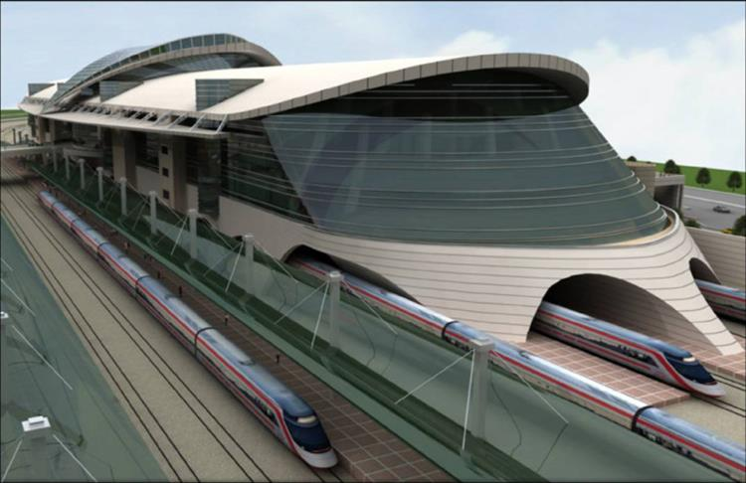
INTRODUCTION

Slide 5
INTRODUCTION
Purpose: making the train boarding/ checking-in process faster, easier and more secure for the passengers.

Slide 6
2. PROBLEM DEFINITION
2.1 The baggage/ body scanning at entry is insufficient and not holistic enough.
2.2 The check-in process is semi-manual and this limited verification process poses security threat.
2.3 Due to understaffed counters and human reliance, the check-in process is slow and inefficient

Slide 7
2.1 THE BAGGAGE/ BODY SCANNING AT ENTRY IS INSUFFICIENT AND NOT HOLISTIC ENOUGH
One X-ray baggage scanner to check all baggages at entering the station
Limited scanning and almost no limitations on carryable items
Luggage always accessible during travel so poses security threat
High volume of passengers entering may result in oversight[3]
Possibility of adding an illegal item afterwards
Standard walkthrough metal detector gates upon entry
Limited scanning for metal items[5]
No specific action taken upon metal beeping
Limited body scanning may result in passengers carrying harmful items like weapons

Slide 8
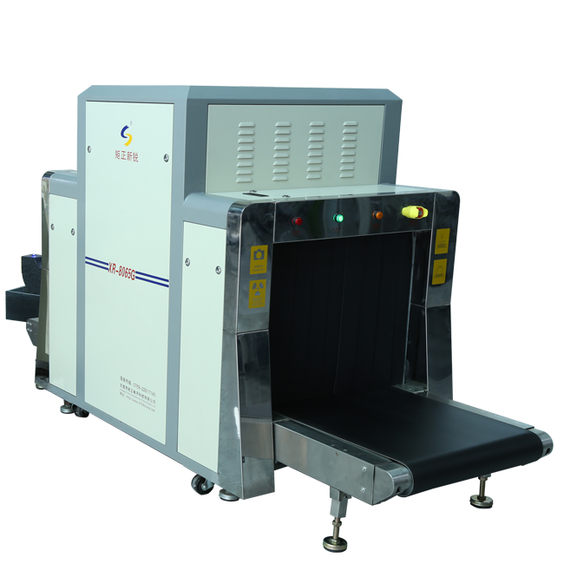
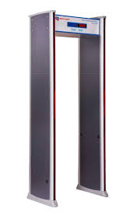
2.1 THE BAGGAGE/ BODY SCANNING AT ENTRY IS INSUFFICIENT AND NOT HOLISTIC ENOUGH

Slide 9
2.2 THE CHECK-IN PROCESS IS SEMI-MANUAL AND THIS LIMITED VERIFICATION POSES SECURITY THREATS
ID/ Passport verification done manually against name on ticket
Possibility of fake documents
Possibility of someone else travelling on another person’s identity
Human error in verification
Oversight on personnel’s part in verifying passenger details
Error by personnel in verifying passenger against the picture on ID card
Lack of accountability and tracking on the passengers that checked in

Slide 10
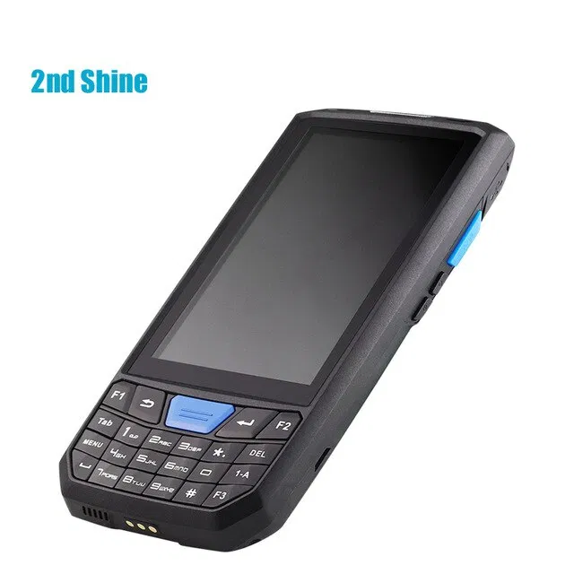
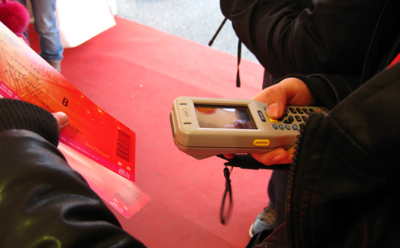
2.2 THE CHECK-IN PROCESS IS SEMI-MANUAL AND THIS LIMITED VERIFICATION POSES SECURITY THREATS

Slide 11
2.3 DUE TO HUMAN RELIANCE AND UNDERSTAFFED COUNTERS, THE CHECK-IN PROCESS IS SLOW AND INEFFICIENT.
Boarding process involves personnel typing passenger names on hand-held devices and verifying their reservations.
Use hand-held GSM-based ticket verification devices[5]
Delay caused during typing.
Any error in spelling names demands the retyping the entire name
Time spent per passenger increased dramatically
Manual verification of documents takes more time per passenger
Manual verification requires personnel to verify Passport/ ID against ticket name
Passenger verification also needed against picture on ID card
Increased time needed per passenger

Slide 12
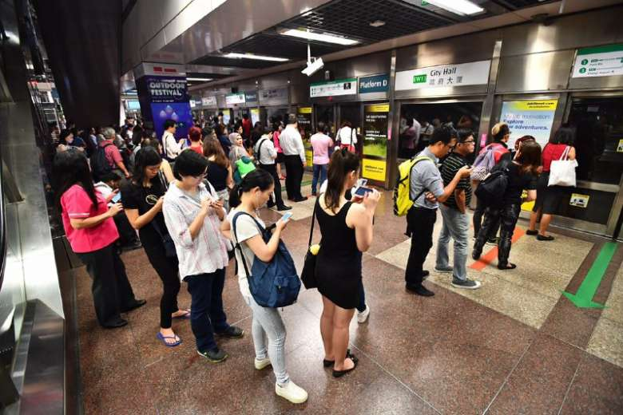
2.3 DUE TO HUMAN RELIANCE AND UNDERSTAFFED COUNTERS, THE CHECK-IN PROCESS IS SLOW AND INEFFICIENT.

Slide 13
3. PROPOSED SOLUTIONS
3.1 Installation of multiple X-ray baggage scanners and multi-zone body scanners at Platform entry points.
3.2 Use of automatic document scanners and FR cameras to verify documents against the travelling passenger
3.3 Installing automatic check-in counters and increasing staffed-counters at the platform

Slide 14
3.1 INSTALLATION OF MULTIPLE X-RAY BAGGAGE SCANNERS AND MULTI-ZONE BODY SCANNERS AT PLATFORM ENTRY POINTS
Installing upto three wide-length X-ray baggage scanners[6] at Platform entry points
Dedicated personnel monitoring and checking the baggage for any illegal items
Separate section for assessment of suspicious baggages
Installation of multi-zone full-body scanners beside the baggage scanners
Holistically checking the travelling passenger for any illegal items like weapons etc. [11]
Separate queue for body search of passengers carrying illegal items

Slide 15
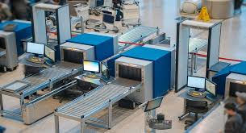
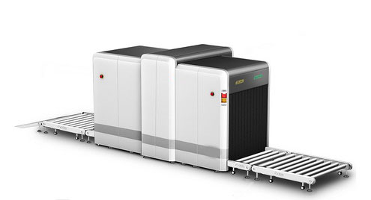
3.1 INSTALLATION OF MULTIPLE X-RAY BAGGAGE SCANNERS AND MULTI-ZONE BODY SCANNERS AT PLATFORM ENTRY POINTS

Slide 16
3.2 USE OF AUTOMATIC DOCUMENT SCANNERS AND FR CAMERAS TO VERIFY DOCUMENTS AGAINST THE TRAVELLING PASSENGER
Installing cloud-backed, optical character recognition(OCR) scanners to scan documents and verify their legitimacy[14]
Using QR code on tickets to verify reservation against scanned document
Using Facial recognition(FR) Cameras to match the travelling passenger against the ID document provided
Use of FR camera to keep record of passenger in a centralized database as well for future reference[15]
Faster document verification and hence, less time spent per passenger

Slide 17
3.3 INSTALLING AUTOMATIC CHECK-IN KIOSKS AND INCREASING STAFFED-COUNTERS AT PLATFORMS
Placing automatic check-in kiosks across the station
Reduce the load on conventional check-in counters at the Platform entrance[12]
Passengers can utilize the automatic document scanners, FR cameras and QR code scanners available on the kiosk to check-in
Use of automatically-generated barcode stub to board the train[10]
Separate queue for passengers who have checked-in already to make their boarding faster
Increasing the number of traditional check-in counters with digitized system
More staff leading to more queues leading to more passengers checking-in faster.

Slide 18
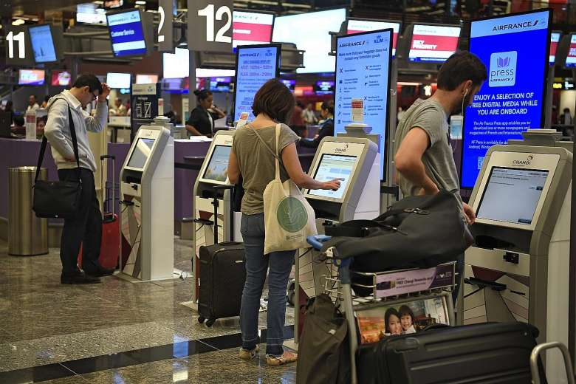
3.3 INSTALLING AUTOMATIC CHECK-IN KIOSKS AND INCREASING STAFFED-COUNTERS AT PLATFORMS

Slide 19
4.0 CRITERIA
4.1 Cost of installing/ acquiring and maintaining the new equipment and software infrastructure (including the cost of human resource needed)
4.2 Reliability of the X-ray baggage scanners, walkthrough security gates, document scanners and other technologies in identifying any irregularities during the boarding process
4.3 Efficiency of the baggage scanners, body scanners, document verification equipment and other technologies in making the boarding process faster and more secure.
4.4 User-friendliness of the automatic check-in kiosks and digital check-in software

Slide 20
5.0 RESEARCH METHODOLOGY
5.1 Passengers will be surveyed to validate user-friendliness of the automatic kiosks
5.2 Market research will be done for equipment installation costs and software infrastructure development/ maintenance costs
5.3 Secondary sources like newspaper articles, research papers, user manuals will be used to learn about the
Standard procedures and regulations of implementing such systems
Learn about similar implementations and utilize that to improve the approach
Verifying the expected outcomes against similar existing infrastructures.

Slide 21
THANK YOU!
QUESTIONS?

Slide 22
REFERENCES
[1] TCDD, “Passenger capacity increases in Ankara?: DW: 12.10.2019,” raillynews.com. [Online]. Available: https://www.raillynews.com/2018/10/50-increased-passenger-capacity-2/. [Accessed: 13-Mar-2020].
[2] “TCDD reports on high speed train operations: DW: 19.02.2010,” uic.org. [Online]. Available: https://uic.org/com/uic-e-news/173/article/tcdd-reports-on-high-speed-train. [Accessed: 13-Mar-2020].
[3] “Evaluating the Relation Between Station Area Design Parameters and Transit Usage for Urban Rail Systems in Ankara, Turkey” DW: 10.03.2020,” springer.com. [Online]. Available: https://link.springer.com/article/10.1007%2Fs40999-020-00506-7. [Accessed: 13-Mar-2020].
[4] “COMPARISON OF HSR LINES IN TURKEY AND THE WORLD AND THEIR SPATIAL IMPACT: A CASE STUDY OF THE ANKARA–KONYA HSR LINE” DW: 12.02.2019,” witpress.com. [Online]. Available: https://www.witpress.com/Secure/elibrary/papers/UT17/UT17047FU1.pdf. [Accessed: 13-Mar-2020].

Slide 23
REFERENCES
[5] HAFİF RAYLI SİSTEMLER HABERLERİ, “Ankara'da günde 400 bin kişi raylı sistemleri kullanıyor” DW: 12.10.2019,” raillynews.com. [Online]. Available: https://www.trenhaber.com/hafif-rayli-sistemler/ankara-da-gunde-400-bin-kisi-rayli-sistemleri-kullaniyor-h1390.html [Accessed: 13-Mar-2020].
[6] “Automation in airport security X-ray screening of cabin baggage: Examining benefits and possible implementations of automated explosives detection” DW: 12.01.2019,” sciencedirect.com. [Online]. Available: https://www.sciencedirect.com/science/article/pii/S000368701830108X. [Accessed: 13-Mar-2020].
[7] “Walk-Through Metal Detectors for Use in Concealed Weapon and Contraband Detection” DW: 10.03.2019,” ncjrs.gov. [Online]. Available: https://www.ncjrs.gov/pdffiles1/nij/193510.pdf. [Accessed: 13-Mar-2020].
[8] “Hand-Held Electronic Ticket Verification Devices” DW: 12.01.2017,” mpdc.dc.gov. [Online]. Available: https://mpdc.dc.gov/page/hand-held-electronic-ticket-issuance-devices [Accessed: 13-Mar-2020].

Slide 24
REFERENCES
[9] “Hold Baggage Security X-Ray Machines” DW: 12.01.2015,” scanxsecurity.com. [Online]. Available: http://www.scanxsecurity.com/hold-baggage-x-ray-machines/ [Accessed: 13-Mar-2020].
[10] “Multi Zone Metal Detector Body Scanner / Walk-Through Metal Detector Gate” DW: 12.01.2019,” securitybaggagescanner.com. [Online]. Available: http://www.securitybaggagescanner.com/sale-10652252-multi-zone-metal-detector-body-scanner-walk-through-metal-detector-gate.html. [Accessed: 13-Mar-2020].
[11] “Ticket queuing times at major rail stations” DW: 12.01.2012,” passengerfocus. [Online]. Available: https://www.transportfocus.org.uk/research-publications/publications/ticket-queuing-times-at-major-rail-stations/. [Accessed: 13-Mar-2020].
[12] “Walk Through Metal Detector, Body Scanner-Indoor Use Metal Detector” DW: 12.01.2017,” safewaysystem.com. [Online]. Available: https://safewaysystem.en.made-in-china.com/product/pXNQIFuOlvWr/China-Walk-Through-Metal-Detector-Body-Scanner-Indoor-Use-Metal-Detector.html[Accessed: 13-Mar-2020].

Slide 25
REFERENCES
[13] “X Ray Baggage Scanner System PSIPL 5030 A” DW: 12.01.2015,” indiamart.com. [Online]. Available: https://www.indiamart.com/proddetail/x-ray-baggage-scanner-system-psipl-5030-a-4061555430.html [Accessed: 13-Mar-2020].
[14] “Multi Zone Metal Detector Body Scanner / Walk-Through Metal Detector Gate” DW: 12.01.2019,” securitybaggagescanner.com. [Online]. Available: http://www.securitybaggagescanner.com/sale-10652252-multi-zone-metal-detector-body-scanner-walk-through-metal-detector-gate.html. [Accessed: 13-Mar-2020].
[15] “Breezing through airport security” DW: 12.09.2012,” straitstimes. [Online]. Available: https://www.straitstimes.com/singapore/breezing-through-airport-security. [Accessed: 13-Mar-2020].
[16] “ Luggage X Ray Machine” DW: 12.01.2017,” bodymetaldetectors.com. [Online]. Available: http://www.bodymetaldetectors.com/sale-9520147-pallet-cargo-luggage-x-ray-machine-with-stainless-steel-body-material-airport-baggage-scanner-screen.html[Accessed: 13-Mar-2020].

Slide 26
REFERENCES
[17] “Airline self-service check-in kiosks mean more time for airport shopping” DW: 12.12.2017,” traveller.com. [Online]. Available: https://www.traveller.com.au/airline-selfservice-checkin-kiosks-mean-more-time-for-airport-shopping-11tbj9[Accessed: 13-Mar-2020].
[18] “Innovative OCR-VCS scanning solution reduces number of unidentifiable luggage items” DW: 12.10.2017,” passengerterminaltoday.com. [Online]. Available: https://www.passengerterminaltoday.com/news/baggage/innovative-ocr-vcs-scanning-solution-reduces-number-of-unidentifiable-luggage-items.html. [Accessed: 13-Mar-2020].

